Slide 1
CHAPTER 11 Unsupervised Learning Methods

Slide 2
All previous methods require a training dataset consisting of the values or labelled that are expected as the predicted output, thus, these leading to the name of supervised learning.
In this chapter, we will discuss a different class of machine learning problems and solutions in which rather than predicting, the aim is to either transform the data or discover patterns without the need of a set of explicit training labels.

Slide 3
We will discuss three major types of unsupervised learning methods:
  Dimensionality reduction
  Clustering
  Frequent pattern mining

Slide 4
Dimensionality Reduction
Dimensionality reduction refers to a set of techniques used to summarize the data in a reduced number of dimensions.
One common application of converting the data to a reduced set of dimensions is visualization.
Another common use of dimensionality reduction is to preprocess the data before further machine learning experiments to simplify the structure and avoid the curse of dimensionality.
Such methods simplify the dataset while still preserving the intrinsic structures and patterns.

Slide 5
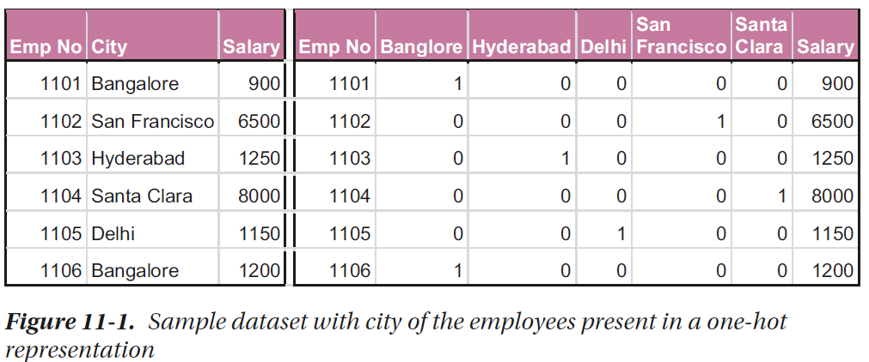
Understanding the Curse of Dimensionality
You’ll often encounter data that is present in high-dimensional spaces.

Slide 6
Principal Component Analysis
Principal component analysis (PCA) is one of the most simple and most common techniques applied for dimensionality reduction.
It transforms the data into a lesser number of dimensions that are almost as informative as the original dataset.
Related to Feature Selection.

Slide 7
The process of performing principal component analysis begins by first computing the covariances of all the columns and storing in a matrix, which summarizes how all the variables are related to each other.
This can be used to find eigenvectors, which show the directions in which the data is dispersed, and eigenvalues, which show the magnitude of the importance along each eigenvector.

Slide 8
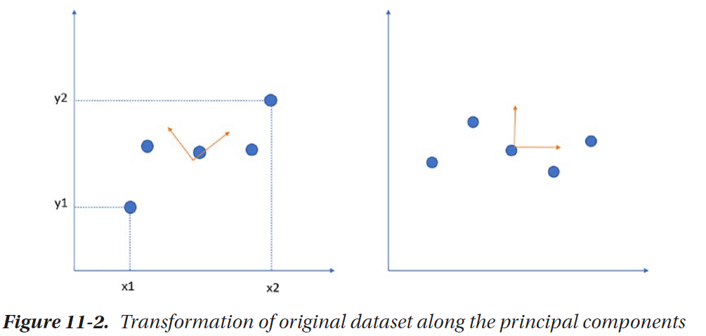
Project (transform) data onto a axis to maximize the spreading (variance).

Slide 9
If PCA tries to find one dimension on which to project the dataset, it will pick this dimension. This is the first principal component.
If we wish to choose the second principal component, we have to choose the axis orthogonal to this. The aim here is to first find the principal components and, second, provide a transformation for mapping original data to the principal components.

Slide 10
To standardize the data to perform PCA, we first compute a d-dimensional mean vector; that is, compute the mean for each column. This is used to standardize the data and bring all the columns on a similar scale.

Slide 11
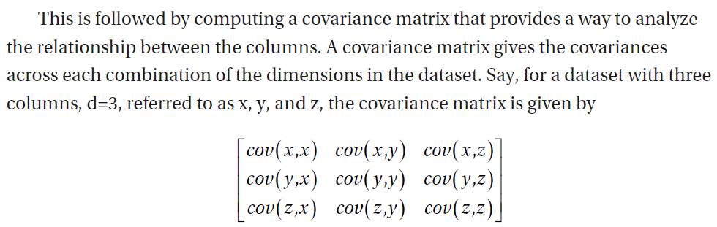

Slide 12
We then compute the eigenvectors and eigenvalues of the covariance matrix to identify the principal components.
The aim of PCA is to find the principal components that explain the maximal amount of variance.
We can decide how many principal components we want and select the two eigenvectors accordingly.

Slide 13
Principal Component Analysis in Python
Let’s see how we can use it to perform PCA in the Iris dataset and use it to visualize it from an entirely different perspective.
We will resolve the four features of IRIS dataset into two principal components, which can be directly mapped on a 2D chart.
  from sklearn import datasets
  iris = datasets.load_iris()
  X = iris.data
  y = iris.target

Slide 14
As you know, there are four columns in the dataset – and it is hard to visualize on a screen. The best we can do at this level is visualize three dimensions (and ignore the fourth).
  from mpl_toolkits.mplot3d import Axes3D
  import matplotlib.pyplot as plt
  fig = plt.figure(1, figsize=(4, 3))
  ax = Axes3D(fig, rect=[0, 0, .95, 1], elev=48, azim=134)
  ax.scatter(X[:, 0], X[:, 1], X[:, 2], c=y, cmap=plt.cm.nipy_spectral,edgecolor='k')

Slide 15
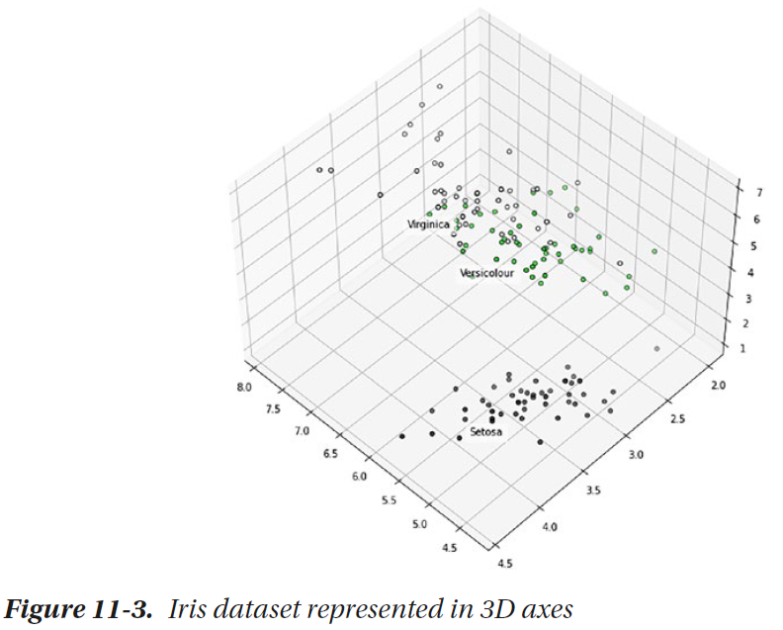

Slide 16
You can print class labels using ax.text3D().
  for name, label in [('Setosa', 0), ('Versicolour', 1), ('Virginica', 2)]:
  ax.text3D(X[y == label, 0].mean(),X[y == label, 1].mean() + 0.5,X[y == label, 2].mean(), name,horizontalalignment='center',bbox=dict(alpha=.5, edgecolor='w', facecolor='w'))
  plt.show()

Slide 17
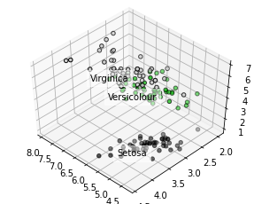

Slide 18
The plot in three dimensions as shown in Figure 11-3 conveys a little more information than the charts we’ve seen before.
However, there is a possibility that there’s something more the missing dimension must convey.
PCA will help us translate the data to two dimensions while making sure that the pattern of distributions is preserved.

Slide 19
To perform PCA, we need to import the required classes and apply fit and transform.
This will convert the dataset to the new two-dimensional space.
  from sklearn import decomposition
  pca = decomposition.PCA(n_components=2)
  pca.fit(X)
  X = pca.transform(X)
  #print(X)

Slide 20
We can visualize using Matplotlib with data points from each representative class (variety of Iris flower) plotted in a different color.
  fig = plt.figure(figsize=(8,8))
  plt.scatter(X[:,0], X[:,1], c=y, cmap=plt.cm.nipy_spectral, edgecolor='k')
  for name, label in [('Setosa', 0), ('Versicolour', 1), ('Virginica', 2)]:
  plt.text(X[y == label, 0].mean(), X[y == label, 1].mean(),name, horizontalalignment='center', bbox=dict(alpha=0.8,edgecolor='w', facecolor='w'))
  plt.show()

Slide 21
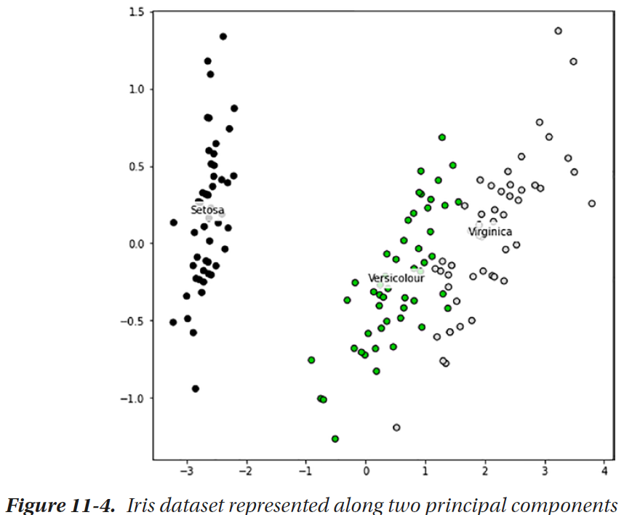

Slide 22
Massive datasets are increasingly widespread in all sorts of disciplines.
To interpret such datasets, we need to decrease dimensionality to preserve the most highly related data.
We can use PCA to reduce the number of variables, avoid multicollinearity, or have too many predictors relative to the number of observations.

Slide 23
Feature reduction is an essential preprocessing step in machine learning. Therefore, PCA is an essential step of preprocessing and very useful for compression and noise removal in the data.
It reduces the dimensionality of a dataset by finding a new set of variables smaller than the original set of variables.

Slide 24
Clustering
Clustering is a suite of simple yet highly effective unsupervised learning methods that help group the data into meaningful groups that reveal an underlying pattern.
We do not have a label based on which the algorithm learns to find the mapping, as we saw in several classification algorithms. Here, the algorithm learns to partition the data based on “distance measures”.

Slide 25
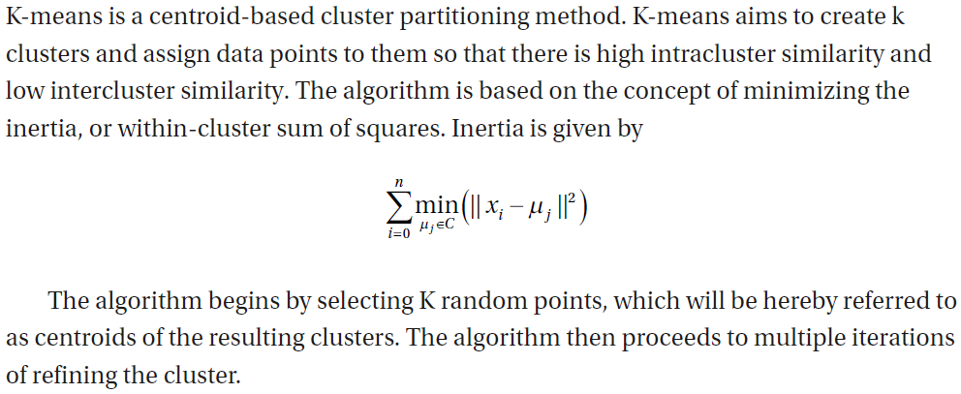
Clustering Using K-Means

Slide 26
In each iteration, for each data point, the algorithm finds the nearest centroid by computing the distances of the point with all the centroids and assigns it to that cluster.
Once all the points are assigned to the clusters, a new centroid is calculated by computing the mean of all the points (across all the dimensions).
This process continues until there is no change of cluster centers or cluster assignments, or after a fixed number of iterations are over.

Slide 27
The algorithm begins with randomly initialized cluster centers. Due to this, a good convergence might not always happen.
In practice, it is a good idea to repeat the clustering algorithm multiple times with randomly initialized cluster centers and sample the final cluster distributions.

Slide 28
K-Means in Python
Scikit-learn provides an efficient implementation of K-means.
Algorithm called k-means++
  Increase the number of clusters till k reached
  Begin with k randomly chosen centers

Slide 29
Let’s generate a synthetic dataset that contains some kind of cluster shapes. Scikit-learn contains such functions in sklearn.datasets.
Figure 11-5 shows a scatter plot showing clearly interpretable clusters of data.
  from sklearn.datasets import make_blobs
  X, y = make_blobs(n_samples=500, centers=5, n_features=2, random_state=2)
  import matplotlib.pyplot as plt
  plt.scatter(X[:,0], X[:,1], edgecolor='k')
  plt.show()

Slide 30
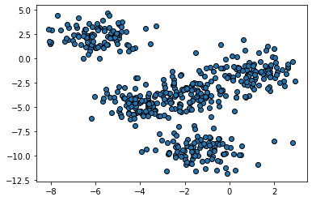

Slide 31
To perform K-means clustering, we need to import KMeans from sklearn.clustering.
The usage is similar to the standard sklearn functions for supervised learning.
  from sklearn.cluster import KMeans
  kmeans = KMeans(n_clusters=5)
  kmeans.fit(X)

Slide 32
Let’s see the clusters that are generated. We will create a scatter plot for the 500 points we generated, and we will assign them a color according to the cluster they are in.
We will also plot the cluster centers with a different color (black) and marker.
  plt.scatter(X[:,0], X[:,1], c=y)
  plt.scatter(kmeans.cluster_centers_[:,0], kmeans.cluster_centers_[:,1],c='black', marker='+')

Slide 33
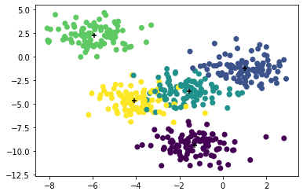

Slide 34
What Is the Right K?
K-means algorithm expects a predetermined value of k.
If there is no deliberate reason to have a predetermined k, it is better to create using K-means for different values of k and analyze the quality of the clusters using the notion of purity or the error.
As we increase the number of k, the error will always decrease – however, we will notice a value of k (or a couple of values) where there’s a significant decrease.
This value is called a knee point and decided as a safe value.

Slide 35
  error = []
  for i in range(1,21):
  kmeans = KMeans(n_clusters=i).fit(X)
  error.append(kmeans.inertia_)
  import matplotlib.pyplot as plt
  plt.plot(range(1,21), error)
  plt.title("Elbow Graph")
  plt.xlabel("No of clusters (k)")
  plt.ylabel("Error (Inertia)")
  plt.xticks([1,2,3,4,5,6,7,8,9,10])
  plt.show()

Slide 36
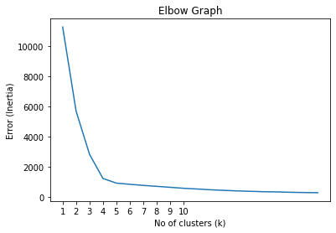

Slide 37
This reduction of error (or improvement of cluster quality) is prominent when the number of clusters increases from 1 to 2, 3, 4, and 5. Beyond that point, the improvement is minimal.
This point, called the knee point, is a good indicator of how many clusters should be found.

Slide 38
Clustering Using DBSCAN
There are several other types of clustering algorithms that are more helpful in cases where the clusters are not expected to be spread evenly in a spherical fashion.
To find such clusters with noticeable nonspherical shapes, we can use density-based methods that model clusters as dense regions separated by sparse regions.

Slide 39
DBSCAN, or Density-Based Spatial Clustering of Applications with Noise, is such a method that tries to combine the regions of space with density of data points greater than a predetermined threshold.
DBSCAN requires a predetermined distance, referred to as eps (for epsilon), which denotes the distance between points to be considered as part of a cluster, and min_ samples, which is the number of data points that must be present in the eps distance to form a dense cluster region.

Slide 40
For experiment in Scikit-learn, let’s construct synthetic data that follows an arbitrary pattern.
  from sklearn.datasets import make_moons, make_circles
  X, y = make_moons(n_samples=1000, noise=0.1)
  plt.scatter(X[:,0], X[:,1], edgecolor='k')

Slide 41
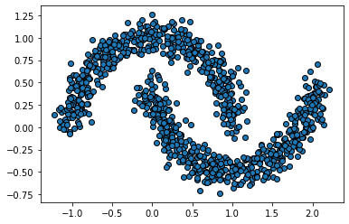

Slide 42
The visualization in Figure 11-12 shows that there are intuitive clusters present in the dataset. If we try to locate the clusters using k-means, we might now achieve the clustering that we expect.
  from sklearn.cluster import KMeans
  kmeans = KMeans(n_clusters=2)
  y= kmeans.fit_predict(X)
  plt.scatter(X[:,0], X[:,1], c=y)

Slide 43
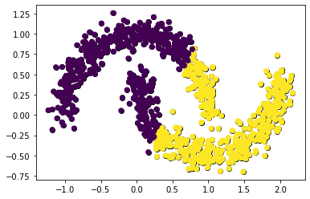

Slide 44
To find the clusters using DBSCAN, we can import DBSCAN from sklearn.clustering.
  from sklearn.cluster import DBSCAN
  dbscan = DBSCAN(eps=0.1, min_samples=2)
  y= dbscan.fit_predict(X)
  plt.scatter(X[:,0], X[:,1], c=y)

Slide 45
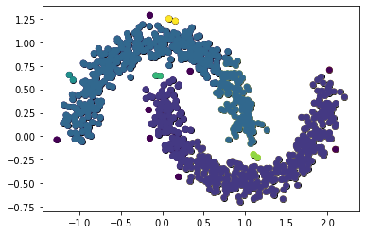

Slide 46
Frequent Pattern Mining
Frequent pattern mining (FP mining) is a very popular problem that finds applications in retail and ecommerce.
FP mining tries to discover repeating (frequent) patterns in the data based on combinations of items that occur together in the dataset.

Slide 47
Market Basket Analysis
A common term that is used in this context is market basket analysis.
It is the process of discovering the items that are usually bought together.
The items that are often bought together can be placed close to each other.
In some deliberate cases, far away from each other, so that the customer has to walk through other shelves, which may make them purchase more than they wanted to.

Slide 48
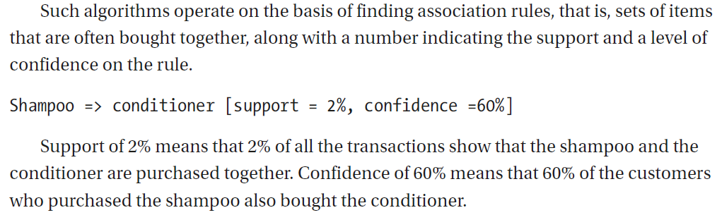

Slide 49
Association rules are considered interesting if they satisfy both a minimum support threshold and a minimum confidence threshold.
These are set either by domain experts or through a set of iterations of careful analysis of the results.

Slide 50
Apriori algorithm begins by determining the support of itemsets in the transactional database.
All the transactions with higher support value than the minimum or selected support value are considered.
This is followed by finding all the rules of the subsets that have higher confidence value than the threshold or minimum confidence.

Slide 51
Apriori algorithm is computationally expensive. In most practical cases, the inventory may contain thousands (or larger order) of items.
Another common issue is when support threshold is lowered to detect certain associations, it also increases the number of nonmeaningful associations.

Slide 52
Another algorithm called FP growth is implemented in most packages used to mine frequent itemsets.
It first compresses the database representing frequent items into a tree-like structure, which retains the itemset association information.
It then divides the compressed dataset into a set of conditional databases, each associated with one frequent item.
Such databases are then mined separately.
FP growth algorithm is much faster compared to apriori algorithm for larger datasets.

Slide 53
Frequent Pattern Mining in Python
We’ve created a CSV containing items purchased in each transaction.
  0,1,2,3,4,5,6
  Bread,Wine,Eggs,Meat,Cheese,Butter,Diaper
  Bread,Cheese,Meat,Diaper,Wine,Milk,Butter
  Cheese,Meat,Eggs,Milk,Wine,,
  Cheese,Meat,Eggs,Milk,Wine,,

Slide 54
from google.colab import drive
drive.mount('/content/drive')
import pandas as pd
import numpy as np
df = pd.read_csv('/content/drive/MyDrive/fpdata.csv')
#print(df)
items = set()
for i in df:
items.update(df[''+str(i)+''].unique())
items.remove(np.nan)
print(items)

Slide 55
We will now convert the dataset into a one-hot encoding form as we saw in previous chapters.
Here’s an alternate method to do the same. The encoded dataframe would look similar to the screenshot shown in Figure 11-15.

Slide 56
  item_list = sorted(items)
  encoded_vals = []
  i=0
  for index, row in df.iterrows():
  labels = dict()
  uncommons = list(items - set(row))
  commons = set(row).intersection(items)
  for item in commons:
  labels[item] = 1
  for item in uncommons:
  labels[item] = 0
  encoded_vals.append(labels)
  one_hot_encoded_dataframe = pd.DataFrame(encoded_vals)
  one_hot_encoded_dataframe

Slide 57
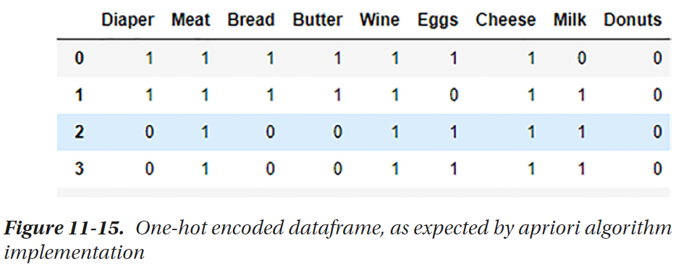

Slide 58
This format is expected by the implementation for apriori algorithm and association rules present in the mlxtend.frequent_patterns.
  from mlxtend.frequent_patterns import apriori, association_rules
  freq_items = apriori(one_hot_encoded_dataframe, min_support = 0.2,
  use_colnames=True)
  freq_items['sup_count'] = freq_items['support']*315
  freq_items

Slide 59
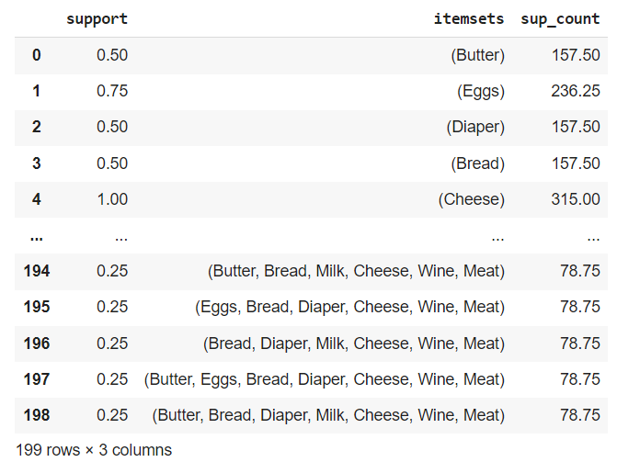

Slide 60
We can also print a list of association rules and the associated confidence scores.
  rules = association_rules(freq_items, metric="confidence", min_threshold=0.5)
  rules

Slide 61
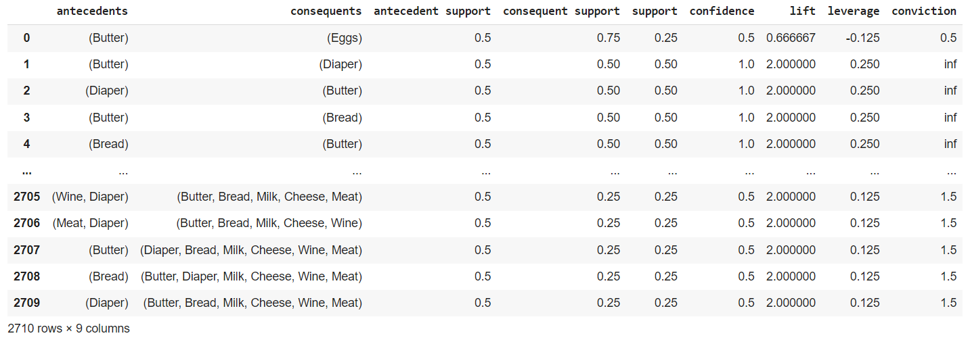

Slide 62
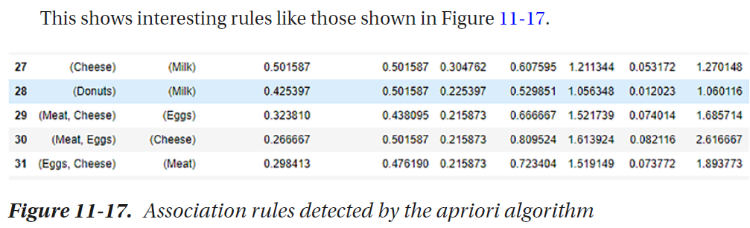

Slide 63
Here, row number 29 indicates that those who bought meat and cheese also bought eggs, which is represented by support of meat and cheese as 0.32, support of eggs as 0.43, and support of the rule with these three items as 0.216.
The associated confidence level is 0.667, which is quite high and reliable. You can explore other details in your dataset.

